Slide 2
Learning Objectives
LO 8.1 Compare and contrast the environments that produce metamorphic, sedimentary, and igneous rocks.
LO 8.2 List and distinguish among the four agents that drive metamorphism.
LO 8.3 Explain how foliated and nonfoliated textures develop.
LO 8.4 List and describe the most common metamorphic rocks.

Slide 3
Learning Objectives (cont.)
LO 8.5 Write a description for each of these metamorphic environments: contact metamorphism, hydrothermal metamorphism, subduction zone metamorphism, and regional metamorphism.
LO 8.6 Explain how index minerals are used to establish the metamorphic grade of a rock body.

Slide 4
8.1 What Is Metamorphism?
Metamorphism means to “change form”
The transition of one rock into another by temperatures or pressures unlike those in which it formed
Changes in mineralogy and sometimes chemical composition
Every metamorphic rock has a parent rock (the rock from which it formed).
Parent rocks can be igneous, sedimentary, or other metamorphic rocks.

Slide 5
8.1 What Is Metamorphism? (cont.)
Metamorphic grade is the degree to which the parent rock changes during metamorphism.
Progresses from low grade (low temperatures and pressures) to high grade (high temperatures and pressures)
During metamorphism, the rock must remain essentially solid.

Slide 6
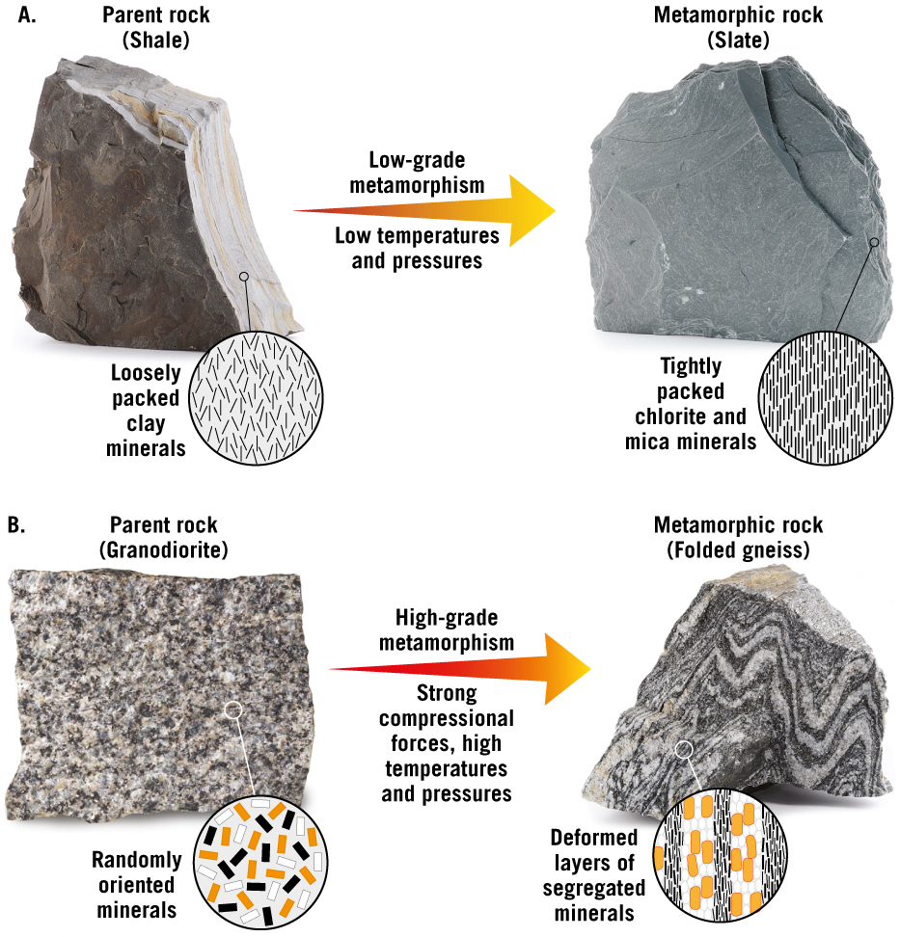
Metamorphic Grade

Slide 7
8.2 What Drives Metamorphism?
Heat
Most important agent
Recrystallization is the process of forming new, stable minerals larger than the original.
Two sources of heat:
Geothermal gradient: An increase in temperature with depth (about 25ºC per kilometer)
Contact metamorphism: Rising mantle plumes

Slide 8
8.2 What Drives Metamorphism? (cont.)
Confining pressure
Forces are applied equally in all directions
Analogous to water pressure
Causes the spaces between mineral grains to close

Slide 9
8.2 What Drives Metamorphism? (cont.)
Differential stress
Forces are unequal in different directions.
Stresses are greater in one direction
Compressional stress
Rocks are squeezed as if in a vice.
Shortened in one direction and elongated in the other direction

Slide 10
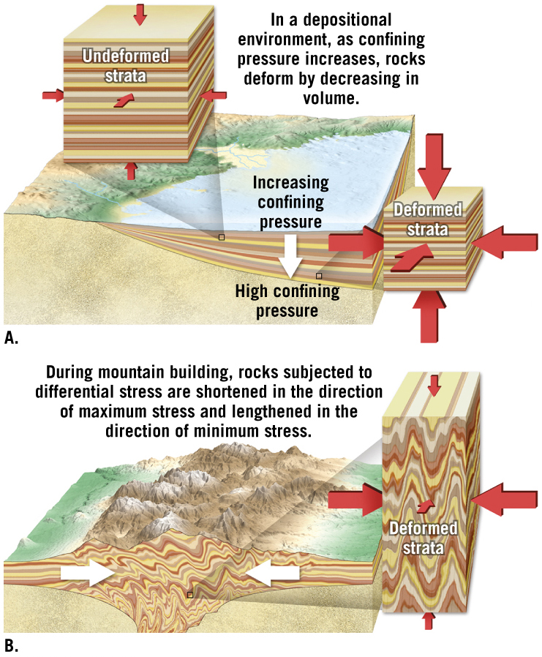
Confining Pressure and Differential Stress
Tutorial

Slide 11
8.2 What Drives Metamorphism?
Chemically active fluids
Enhances migration of ions
Aids in recrystallization of existing minerals
In some environments, fluids can transport mineral matter over considerable distances.

Slide 12
8.2 What Drives Metamorphism? (cont.)
The importance of parent rock
Most metamorphic rocks have the same overall chemical composition as the original parent rock.
Mineral makeup determines the degree to which each metamorphic agent will cause change.

Slide 13
8.3 Metamorphic Textures
Texture describes the size, shape, and arrangement of mineral grains.
Metamorphic rocks can display preferred orientation of minerals, in which the platy mineral grains exhibit parallel to subparallel alignment.

Slide 14
8.3 Metamorphic Textures (cont.)
Foliation describes any planar arrangement of mineral grains or structural features within a rock.
Examples of foliation
Parallel alignment of platy or elongated minerals
Parallel alignment of flattened mineral grains or pebbles
Compositional banding of dark and light minerals
Cleavage where rocks can be easily split into slabs

Slide 15
8.3 Metamorphic Textures (cont.)
Foliation
Foliation can form in various ways, including:
Rotation of platy minerals
Recrystallization that produces new minerals perpendicular to the direction of maximum stress
Flattening spherically shaped grains

Slide 16
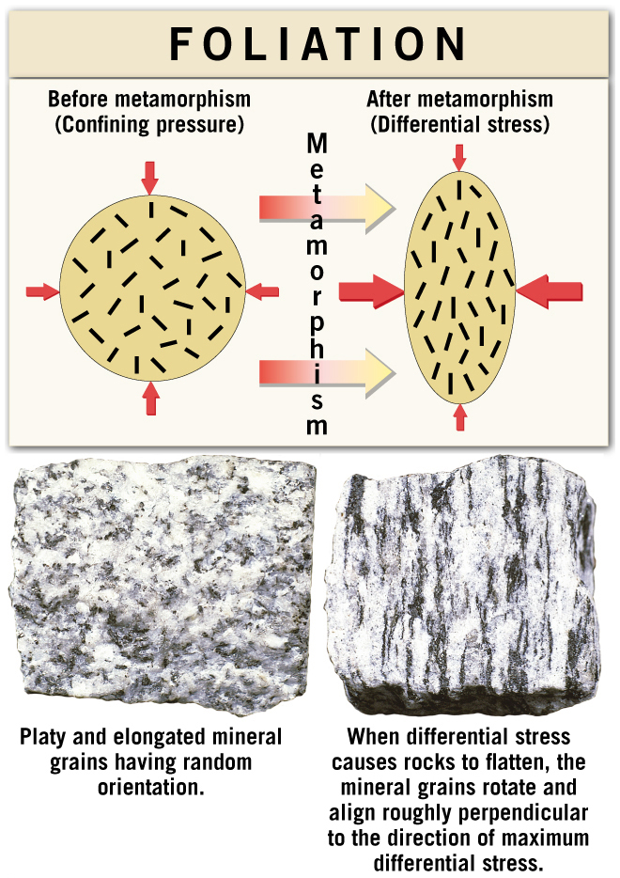
Development of Foliation as a Result of Differential Stress
Animation

Slide 17
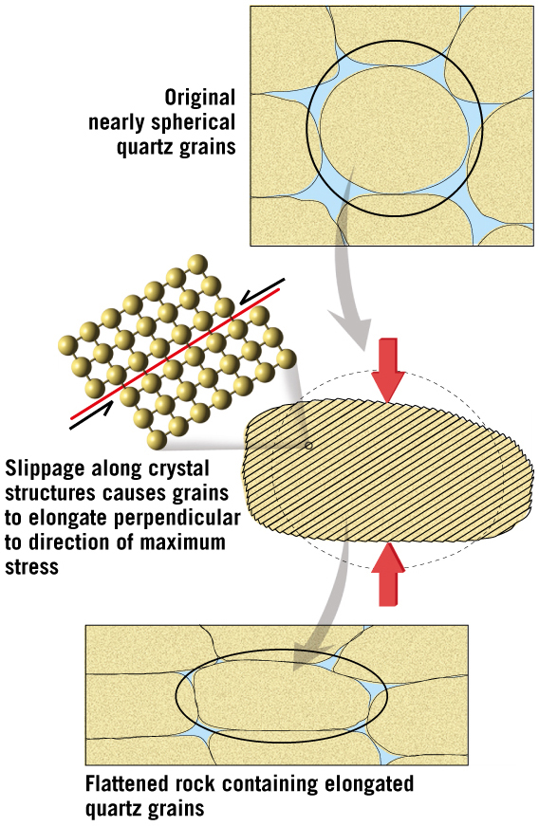
Solid-State Flow of Mineral Grains

Slide 18
8.3 Metamorphic Textures
Foliated textures
Rock or slaty cleavage
Rocks split into thin slabs
Develops in beds of shale with low-grade metamorphism

Slide 19
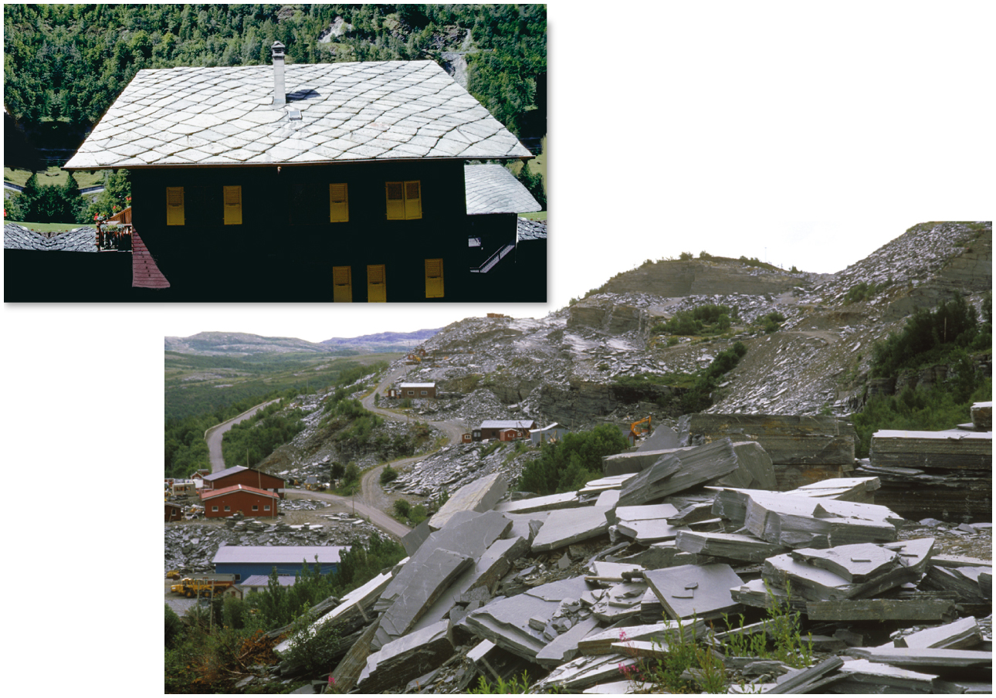
Excellent Slaty Cleavage

Slide 20
8.3 Metamorphic Textures
Foliated textures
Schistosity
Platy minerals are discernible with the unaided eye.
Mica and chlorite flakes begin to recrystallize into large muscovite and biotite crystals.
Exhibit a planar or layered structure
Rocks having this texture are referred to as schist.

Slide 21
8.3 Metamorphic Textures (cont.)
Foliated textures
Gneissic texture
During high-grade metamorphism, ion migration results in the segregation of minerals into light and dark bands.
Metamorphic rocks with this texture are called gneiss.
Although foliated, gneiss do not usually split as easily as slates and schists.

Slide 22
8.3 Metamorphic Textures (cont.)
Other metamorphic textures
Nonfoliated metamorphic rocks are composed of minerals that exhibit equidimensional crystals and lack foliation.
Develop in environments in which deformation is minimal
Porphyroblastic textures
Unusually large grains, called porphyroblasts, are surrounded by a fine-grained matrix of other minerals.

Slide 23
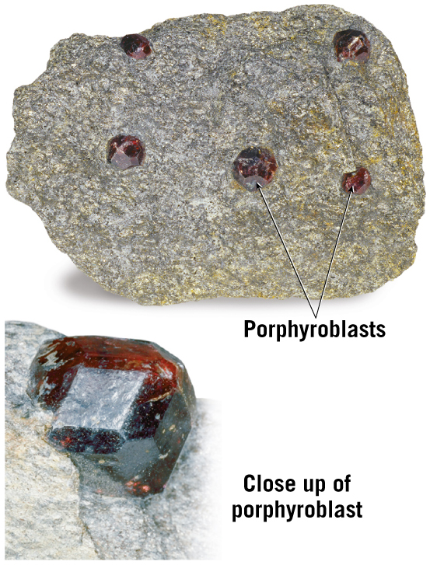
Garnet-Mica Schist

Slide 24
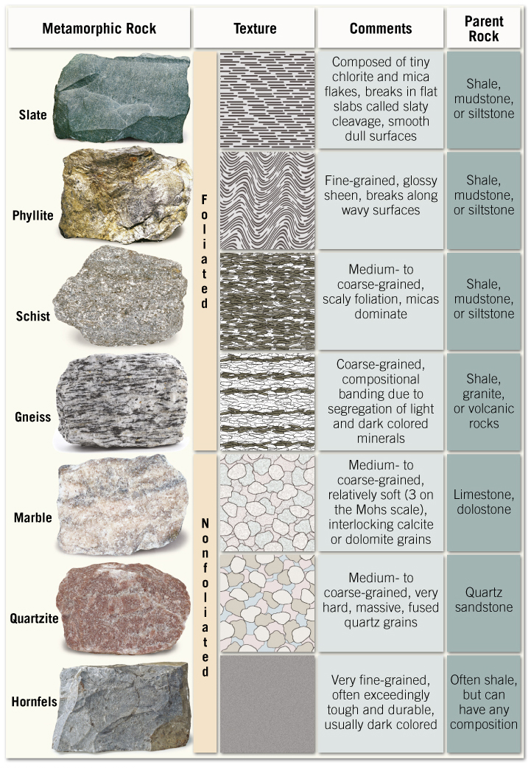
8.4 Common Metamorphic Rocks

Slide 25
8.4 Common Metamorphic Rocks (cont.)
Foliated rocks
Slate
Very fine-grained
Excellent rock cleavage
Most often generated from low-grade metamorphism of shale, mudstone, or siltstone

Slide 26
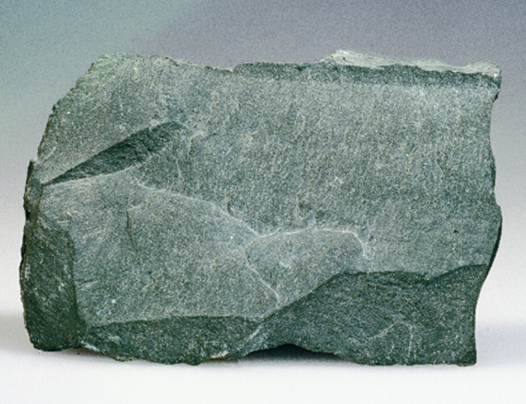
Slate

Slide 27
8.4 Common Metamorphic Rocks
Foliated rocks
Phyllite
Degree of metamorphism between slate and schist
Platy minerals are larger than slate but not large enough to see with the unaided eye.
Glossy sheen and wavy surfaces
Exhibits rock cleavage

Slide 28
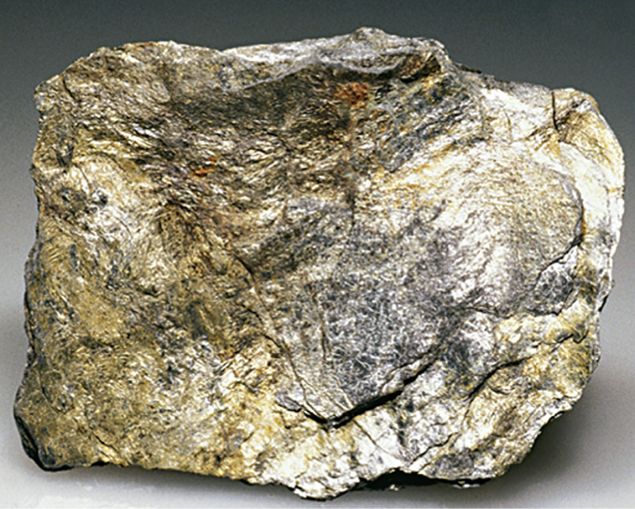
Phyllite

Slide 29
8.4 Common Metamorphic Rocks
Foliated rocks
Schist
Medium- to coarse-grained
Parent rock is shale that has undergone medium- to high-grade metamorphism.
The term schist describes the texture.
Platy minerals (mainly micas) predominate
Can also contain porphyroblasts

Slide 30
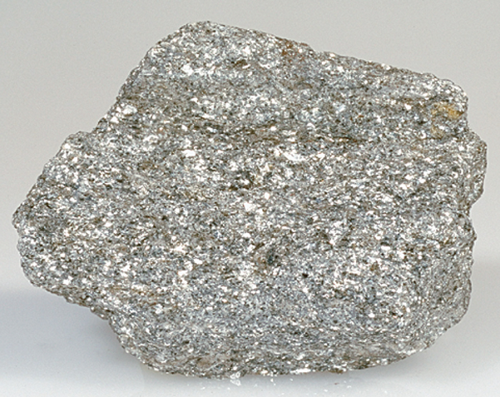
Schist

Slide 31
8.4 Common Metamorphic Rocks
Foliated rocks
Gneiss
Medium- to coarse-grained metamorphic rock with a banded appearance
The result of high-grade metamorphism
Composed of light-colored, feldspar-rich layers with bands of dark ferromagnesian minerals

Slide 32
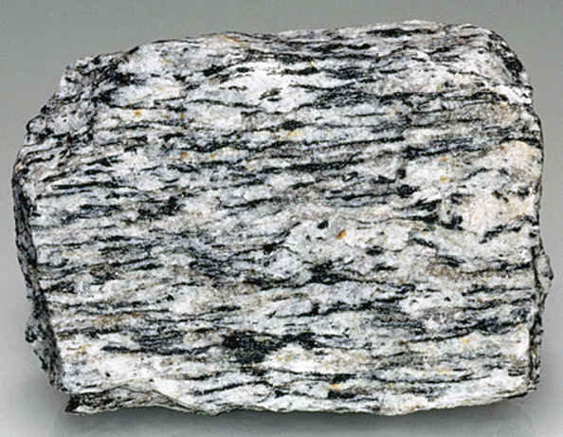
Gneiss

Slide 33
8.4 Common Metamorphic Rocks
Nonfoliated rocks
Marble
Crystalline rock from limestone or dolostone parent rock
Main mineral is calcite
Calcite is relatively soft (3 on the Mohs scale)
Used as a decorative and monument stone
Impurities in the parent rocks provide a variety of colors.

Slide 34
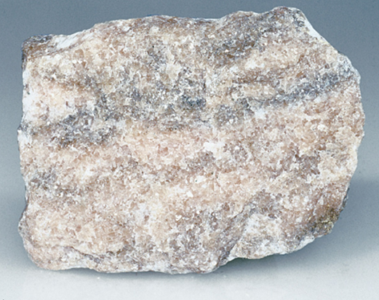
Marble

Slide 35
8.4 Common Metamorphic Rocks
Nonfoliated rocks
Quartzite
Formed from a parent rock of quartz-rich sandstone
Quartz grains are fused together
Pure quartzite is white
Iron oxide may produce reddish or pink stains.
Dark minerals may produce green or gray stains.

Slide 36
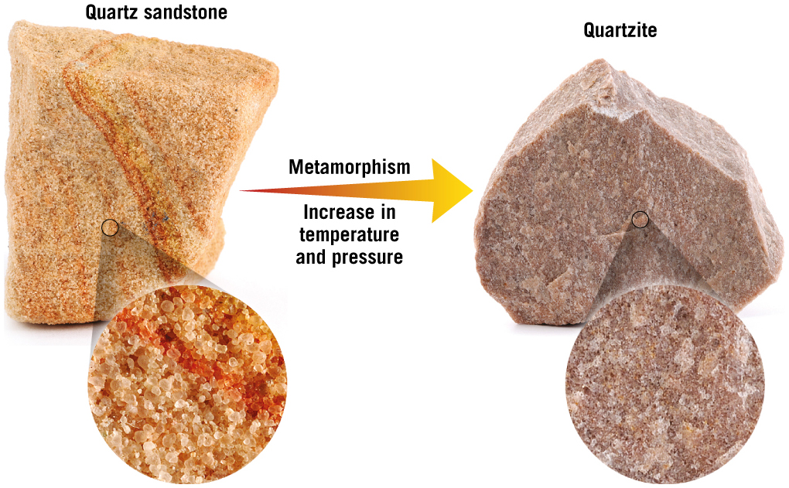
Quartzite

Slide 37
8.4 Common Metamorphic Rocks
Nonfoliated rocks
Hornfels
Parent rock is shale or clay-rich rocks.
“Baked” by an intruding magma body

Slide 38
8.5 Metamorphic Environments
Contact or thermal metamorphism
Results from a rise in temperature when magma invades a host rock
Occurs in the upper crust (low pressure, high temperature)
The zone of alteration (aureole) forms in the rock surrounding the magma.

Slide 39
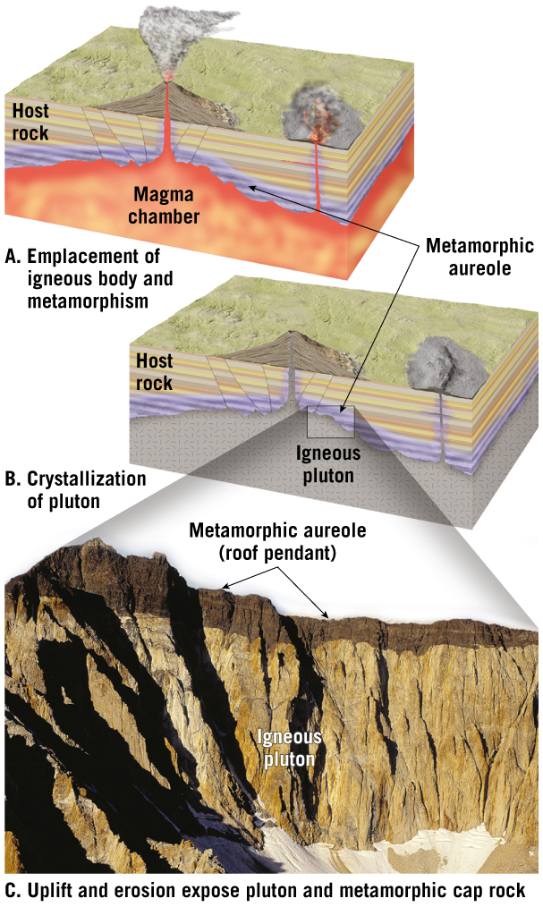
Contact Metamorphism
Tutorial

Slide 40
8.5 Metamorphic Environments
Hydrothermal metamorphism
Chemical alteration caused by hot, ion-rich fluids circulating through pore spaces and rock fractures.
Typically occurs along the axes of mid-ocean ridges.
Black smokers are the result of the fluids gushing from the seafloor.

Slide 41
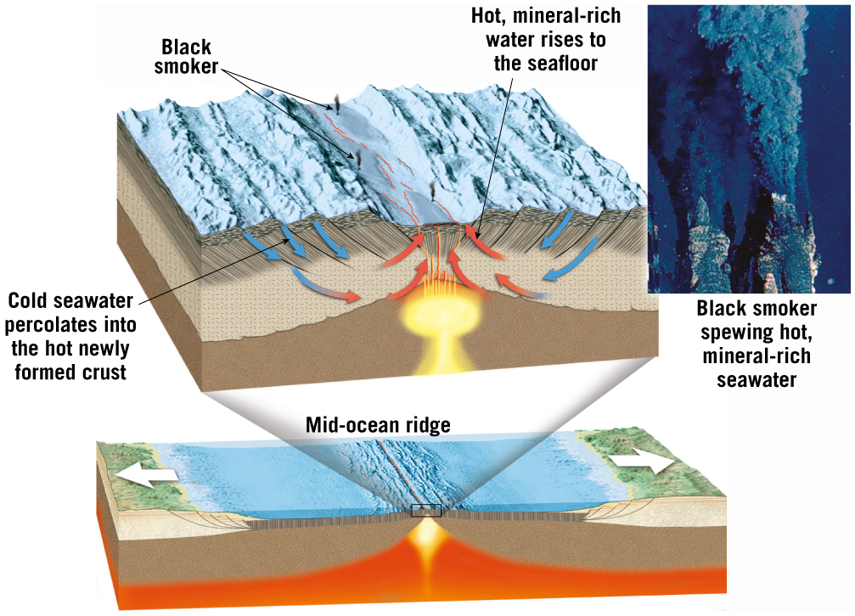
Hydrothermal Metamorphism along a Mid-Ocean Ridge

Slide 42
8.5 Metamorphic Environments
Burial metamorphism
Associated with very thick sedimentary strata in a subsiding basin
Gulf of Mexico is an example.
Subduction zone metamorphism
Sediments and oceanic crust are subducted fast enough that pressure increases before temperature.

Slide 43
8.5 Metamorphic Environments (cont.)
Regional metamorphism
Produces the greatest quantity of metamorphic rock
Associated with mountain building and the collision of continental blocks

Slide 44
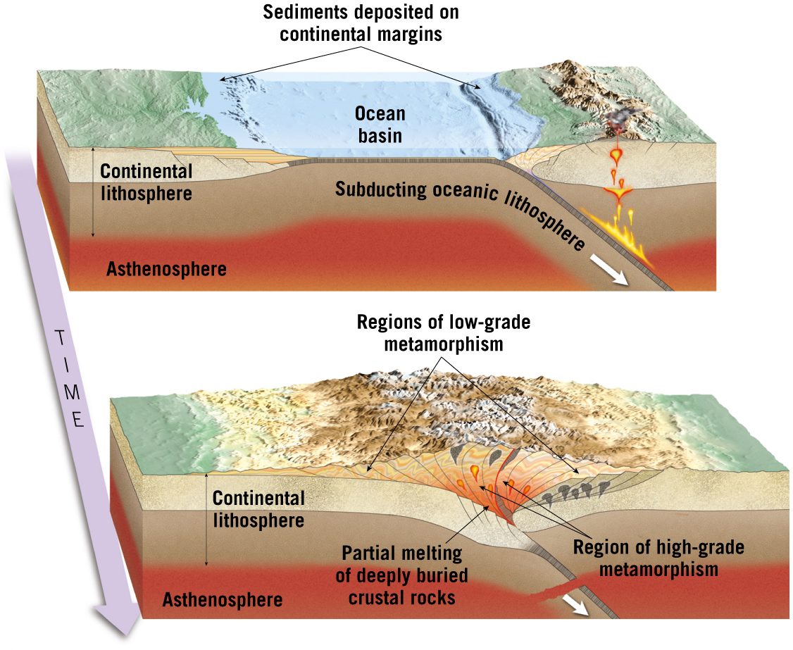
Regional Metamorphism

Slide 45
8.5 Metamorphic Environments
Metamorphism along fault zones
Occurs at depth and high temperatures
Preexisting minerals deform by ductile flow
Mylonites form in these regions of ductile deformation.
Impact metamorphism
Occurs when meteorites strike Earth’s surface
Products of these impacts are fused fragmented rock and glass-rich ejecta that resemble volcanic bombs, called impactiles.

Slide 46
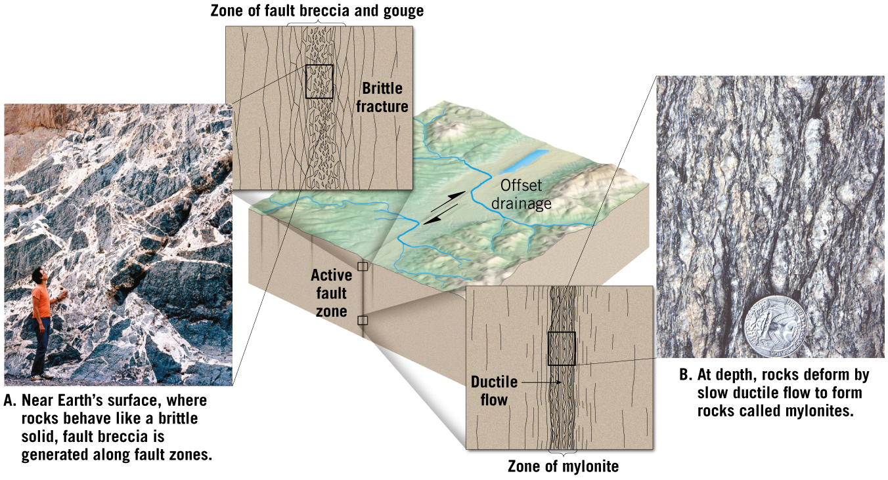
Metamorphism along a Fault Zone
Tutorial

Slide 47
8.6 Metamorphic Zones
Textural variations
Slate is associated with low-grade metamorphism.
Gneiss is associated with high-grade metamorphism.
Phyillte and schist are intermediate.

Slide 48
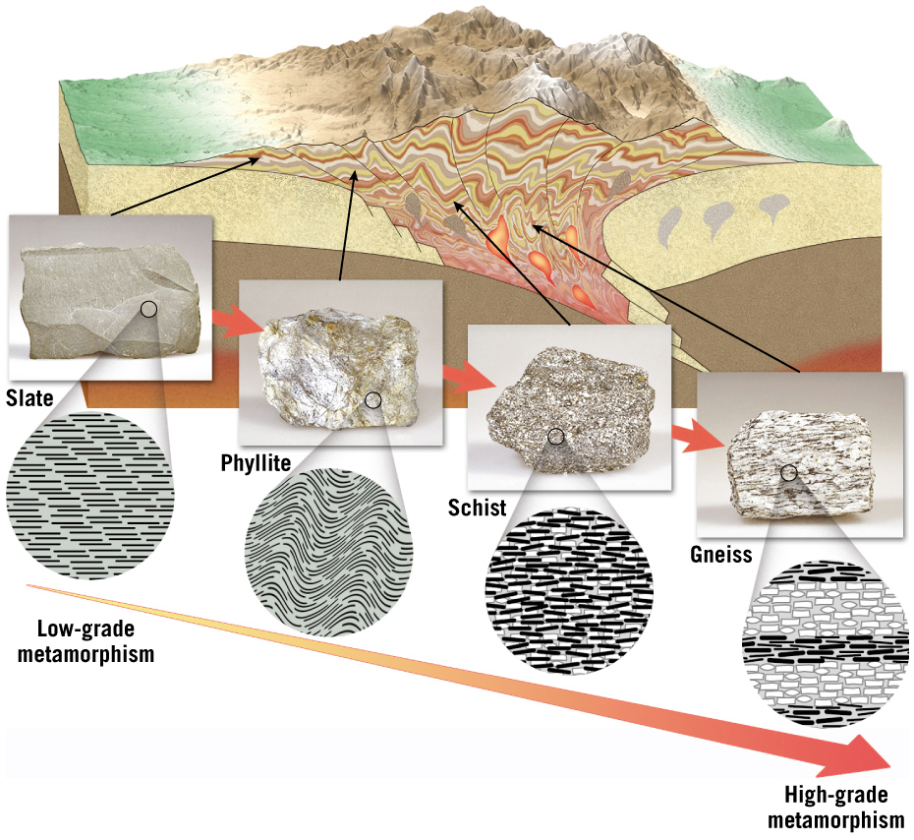
Textural Variations Caused by Regional Metamorphism
Tutorial

Slide 49
8.6 Metamorphic Zones
Index minerals and metamorphic grade
Changes in mineralogy occur from regions of low-grade metamorphism to regions of high-grade metamorphism.
Index minerals are good indicators of metamorphic environments
Migmatites are rocks that are partially melted.
Represent the highest grades of metamorphism
Transitional to igneous rocks

Slide 50
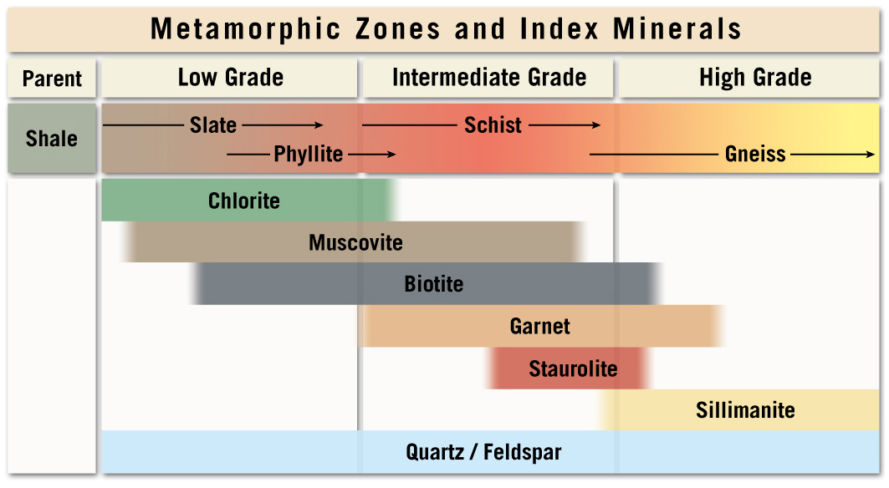
Metamorphic Zones and Index Minerals

